Slide 1


Slide 2

Major Project-I (01CE0716)
Review 1 (12/07/2025)
Lung Cancer Prediction using SHAP and DL techniques
Team ID: 7CE_147
Team Member 1: SHUBHAMKUMAR PANDIT (92200103155) (7TC2)
Team Member 2: NEEHARIKA JOSHI (92200103099) (7TC2)
Guided By
Internal Guide Name: Prof. Shailendrasinh Chauhan
Department of Computer Engineering, Faculty of Engineering & Technology

Slide 3
Outlines
Introduction
Abstract
Literature Review
Limitations Identified in Literature Review
System Design (Workflow)
Methodology
Data Collection
Data Visualization
1. Textual Data
2. CT Scan Based Data
Model Evaluation
1. Graphical Representation of Model’s Accuracy
2. Graphical Representation of Model’s F1_Score
3. Precision Vs Recall Comparison
Project Scheduling (Gantt Chart)
Tech Stack
Future Work
Conclusion
References

Slide 4
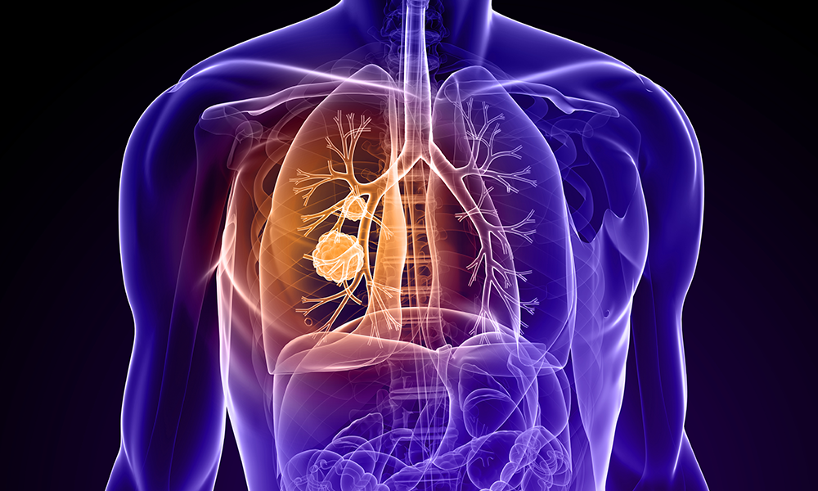
Introduction
Every year, over 2.2 million people are diagnosed with lung cancer worldwide, and sadly, more than 1.8 million lose their lives, making it the leading cause of cancer-related deaths globally. The biggest challenge? Late diagnosis, when treatment is often too little, too late.
In our project, “Lung Cancer Prediction using SHAP and Machine Learning Techniques,” we tackle this issue head-on using cutting-edge AI and explainable machine learning models.
We worked with a text-based dataset of 5,000 records spanning 18 medical attributes like age, smoking history, oxygen saturation, and family background. We also explored CT scan images, classifying them into Benign, Malignant, and Normal, a crucial step in identifying early-stage lung cancer.
Using models like Random Forest and Logistic Regression, we achieved high levels of predictive accuracy but we didn’t stop there. To ensure doctors can trust and understand these predictions, we implemented SHAP (SHapley Additive exPlanations), which reveals the exact contribution of each feature to the model's decision, making the black-box model a transparent one.
By merging AI precision with human interpretability, our solution aims to accelerate early detection, reduce diagnostic errors, and ultimately contribute to saving millions of lives.

Slide 5
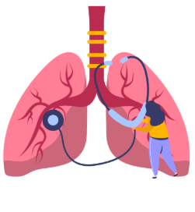
Abstract
Lung cancer is one of the most prevalent and deadly forms of cancer, often detected at an advanced stage when treatment options are limited and survival rates decline sharply. This project aims to address the challenge of early detection by leveraging machine learning (ML) techniques and explainable AI (XAI) frameworks. We employ algorithms such as Random Forest and Logistic Regression on a comprehensive text-based dataset of 5,000 samples with 18 clinical features, as well as CT scan images, to classify cases into Benign, Malignant, or Normal.
To enhance model interpretability, we integrate SHAP (SHapley Additive exPlanations), which provides clear, feature-level insights into each prediction. This not only improves the transparency and reliability of the model but also equips healthcare professionals with actionable explanations, fostering trust in AI-assisted diagnostics. Our approach combines predictive accuracy with interpretability, aiming to support timely and informed clinical decisions, and ultimately contribute to the early and effective diagnosis of lung cancer.

Slide 6
Literature Review
Ref. No. | Year | Dataset | Results | Methodology | Limitations
[1] | 2024 | LIDC-IDRI (Lung Image Database Consortium and Image Database Resource Initiative) LIDC-IDRI-DA-RAD (a variant of LIDC-IDRI with additional radiologist annotations) | Accuracy: 98% AUC (SVM): 0.9875 Training Accuracy (KNN): Lower than 98% (exact not given) | Used ML on 309 samples (16 features); removed age, gender, anxiety after correlation. Trained LR, SVM, KNN; evaluated using accuracy and AUC. | Limitations include small self-reported dataset which may introduce bias and limit generalizability. The study uses binary classification without considering cancer stages. Important factors such as genetics and environmental exposure are not included. KNN model shows overfitting which affects reliability.
[2] | 2024 | Patient symptom and medical history data collected through questionnaires covering symptoms like cough, wheezing, yellow fingers, fatigue, etc. CT scan images obtained for patients classified as medium or high risk based on questionnaire analysis. | Random Forest Accuracy: 96.11% XGBoost Accuracy: 95.92% AdaBoost Accuracy: 95.74% | Used Random Forest, AdaBoost, XGBoost for lung cancer prediction. Handled imbalance with SMOTE and improved performance using Bayesian hyperparameter tuning. | Results depend on dataset quality and diversity as limited data may affect generalizability. Validation in real-world clinical settings is still required. Some important patient factors such as genetics and environment may be missing from the dataset.

Slide 7
Literature Review
Ref. No. | Year | Dataset | Results | Methodology | Limitations
[3] | 2024 | BIR Lung Dataset LIDC-IDRI (Lung Image Database Consortium and Image Database Resource Initiative) | XGBoost Accuracy: 96.92% LightGBM Accuracy: ~93.5% AdaBoost Accuracy: ~92.3% Logistic Regression Accuracy: 67.41% | Collected data from 5000 patients (25 features, 5 hospitals). Applied preprocessing, feature selection (RapidMiner), 10-fold CV. Evaluated XGBoost, LightGBM, AdaBoost, LR, and SVM. | Data was manually collected from a specific region which may limit generalizability. Only structured tabular data was used without imaging or genomic inputs. Deep learning techniques such as CNNs were not applied. Real-time clinical deployment was not evaluated.
[4] | 2024 | Lung Cancer Dataset from the UCI Machine Learning Repository LIDC-IDRI (Lung Image Database Consortium and Image Database Resource Initiative) | KNN Accuracy: 92.86% Bernoulli NB Accuracy: 91.07% Gaussian NB Accuracy: 91.07% Other Models (SVM, RF, XGB, MLP): Accuracy between 85% – 89% | Used 310 patient records (16 features) from Kaggle. Preprocessed data (deduplication, encoding, gender-wise analysis). Applied 10-fold CV (80/20 split). Compared LR, NB (Gaussian/Bernoulli), SVM, RF, KNN, XGBoost, Extra Tree, AdaBoost, MLP, and two ensembles (XGB+ADA, Voting). | The dataset size was limited to 310 samples which affects generalizability. Only tabular data was used without imaging or genomic features. Attribute correlations were moderate and results may differ on real-world EHR data. Future work should explore larger datasets and advanced ensemble methods for validation.

Slide 8
Literature Review
Ref. No. | Year | Dataset | Results | Methodology | Limitations
[5] | 2024 | Cleveland Hospital Records National Lung Screening Trial (NLST) Prostate, Lung, Colorectal, and Ovarian (PLCO) Cancer Screening Trial | Logistic Regression: Accuracy: 52% Precision: 52% Recall: 57% F1 Score: 54% Random Forest Accuracy: 50% XGBoost Accuracy: 49% | Used 3000 samples from Cleveland, public health, and NLST/PLCO datasets. Features: demographic, lifestyle, clinical symptoms. Applied LR, RF, XGBoost with preprocessing and encoding. Evaluated via accuracy, precision, recall, and F1 score. | Models showed low accuracy due to a small and noisy dataset. Important features may be missing and class imbalance could be present. Advanced models underperformed likely because of limited data quality. Imaging and genetic data were not included.
[6] | 2024 | The study used a proprietary dataset of 10,000 patient records with clinical and radiographic data for lung cancer prediction. | KNN: Accuracy: 95.0% Precision: 90.5% Recall: 93.8% F1-Score: 92.1% Decision Tree Accuracy: 87.8% Random Forest Accuracy: 89.2% SVM Accuracy: 90.4% | Used 10,000 patient records with demographic, lifestyle, medical, and radiographic features. Applied imputation, IQR outlier removal, Z-score normalization. Split: 50% train, 15% val, 15% test. Used KNN (k=5, Euclidean). Implemented in Python. | KNN is computationally intensive on large datasets, sensitive to irrelevant features, and its performance can degrade in high-dimensional spaces. Its effectiveness relies heavily on proper feature selection.

Slide 9
Literature Review
Ref. No. | Year | Dataset | Results | Methodology | Limitations
[7] | 2024 | National Lung Screening Trial (NLST) Prostate, Lung, Colorectal, and Ovarian (PLCO) Cancer Screening Trial LIDC-IDRI | Random Forest Accuracy: 100% Decision Tree Accuracy: 100% KNN Accuracy: 99% SVM Accuracy: 96.3% | Used 1000 records with 22 features (demographic, lifestyle, medical). Applied SVM, KNN, DT, RF with Grid Search tuning. Used XAI methods: decision boundaries, LIME, and tree visualization. | Model performance depends on dataset quality and available features. Bias may arise from underrepresented demographics. High accuracy could indicate overfitting. There is a risk of false positives or negatives. Age and gender showed low feature importance.
[8] | 2022 | SEER (Surveillance, Epidemiology, and End Results) dataset – comprising 1,000 patient records. Data World dataset – comprising 1,000 patient records. Lanzhou University dataset – comprising 277 patient records. HRQOL (Health-Related Quality of Life) dataset – comprising 809 patient records. UCI Lung Cancer dataset – comprising 32 patient records. | XGBoost: Accuracy: 94.42% Precision: 95.66% Recall: 94.46% F1-Score: 94.74% AUC: 98.14% LightGBM Accuracy: 92.56% LightGBM AUC: >97% AdaBoost Accuracy: 90.70% AdaBoost AUC: >97% Bagging Accuracy: 89.76% Bagging AUC: 95.30% | Applied XGBoost, LightGBM, AdaBoost, and Bagging on Kaggle dataset (309 samples, 16 features). Performed preprocessing, handled imbalance with SMOTE, and used 10-fold CV. Evaluated with accuracy, precision, recall, F1-score, and AUC. | The small dataset size of 309 samples may limit generalizability. Reliance on survey data introduces potential bias or inaccuracies. Only symptom-based features were used, excluding key factors like genetics and environmental exposures. Clinical validation is needed to confirm effectiveness in real-world settings. Results may not generalize to other populations without additional studies.

Slide 10
Literature Review
Ref. No. | Year | Dataset | Results | Methodology | Limitations
[9] | 2022 | A Kaggle-based lung cancer dataset containing patient symptom and lifestyle information | Random Forest: Accuracy: 92.3% Precision: 97% F1-Score: 95% Decision Tree Accuracy: 91% Logistic Regression Accuracy: 89.7% SVM: Accuracy: 88.5% Recall: 95.6% | Used lung cancer dataset (13 features) from Kaggle. Implemented four machine learning algorithms Random Forest, SVM, Logistic Regression, and Decision Tree on Google Colab using Python. Evaluation was based on accuracy, precision, recall, and F1-score (harmonic mean). | The dataset lacked size and diversity. Only traditional machine learning models on tabular data were applied without deep learning or imaging-based methods. SVM performed poorly with noisy inputs and logistic regression was limited by its linearity assumption. External validation or cross-validation was not reported.
[10] | 2021 | LIDC‑IDRI (The Lung Image Database Consortium image collection) TCIA datasets (e.g., “RIDER-LUNGCT-SEG”, “QIN-LUNGCT-SEG”) Kaggle lung cancer datasets (CT or clinical) LC25000 for histopathology images | CNN Accuracy: up to 97.2% ANN Accuracy: up to 96.67% SVM Accuracy: up to 96.7% | Review paper summarizing ML/DL methods for lung cancer detection. Covers preprocessing (filtering, CLAHE), segmentation (watershed, k-means), feature extraction (GLCM, PCA, CNN), and classification (SVM, ANN, CNN). Uses datasets: LIDC-IDRI, LUNA16, Kaggle DSB. | The study is review-based and does not include new dataset evaluation. Most referenced methods rely on large labeled datasets and may suffer from overfitting. Model comparisons lack unified benchmarking, limiting consistent performance assessment.

Slide 11
Literature Review
Ref. No. | Year | Dataset | Results | Methodology | Limitations
[11] | 2020 | IQ-OTH/NCCD | Accuracy (SVM): 83.33% Training Samples: 35 Testing Samples: 30 Classes: Normal, Benign, Malignant | CT scan images are preprocessed (grayscale, thresholding), segmented via contour detection. GLCM is used to extract features (area, contrast, energy, entropy, homogeneity). SVM is applied for classification. | The dataset included only 35 training samples, limiting robustness. Handcrafted features were used, while deep learning could offer better performance. Binary thresholding may lose important details in complex CT images. Only SVM was evaluated without comparison to other classifiers.
[12] | 2018 | LIDC-IDRI LUNA16 Kaggle DSB 2017 | SVM AUC (Oxford dataset): 0.854 CNN AUC (Kaggle DSB 2017): up to 0.87 | Used CT imaging data. Applied logistic regression models (e.g., Brock), radiomics (texture features), SVM classifiers, and CNNs. Evaluated using cross-validation and AUC on datasets like LIDC-IDRI and PLAN. | Limitations include high false positive rates in LDCT screening, reliance on subjective inputs in risk models, overfitting risks in radiomics, the need for large, well-annotated datasets for CNNs, and challenges in clinical adoption and integration.

Slide 12

Limitations Identified in Literature Review
Lack of Explainability: Most studies used black-box models without providing interpretability for medical professionals.
Small or Unbalanced Datasets: Several papers relied on limited or imbalanced data, reducing the generalizability of results.
Limited Real-World Application: Few papers validated their models with clinical or real-time data.
Performance Trade-offs: Some models showed high accuracy but struggled with precision/recall in detecting malignant cases.
Overfitting Concerns: Complex models like deep neural networks were prone to overfitting, especially with small datasets.
Feature Selection Limitations: Many studies used basic or manual feature selection, missing out on automated, data-driven techniques.
Limited Use of Ensemble Methods: Not all papers explored the power of ensemble approaches like RF, XGBoost.
Lack of Multimodal Integration: Few studies combined clinical text data and CT scan image analysis effectively.
No Focus on Early Detection: Some models performed well overall but lacked sensitivity in detecting early-stage cancer.

Slide 13
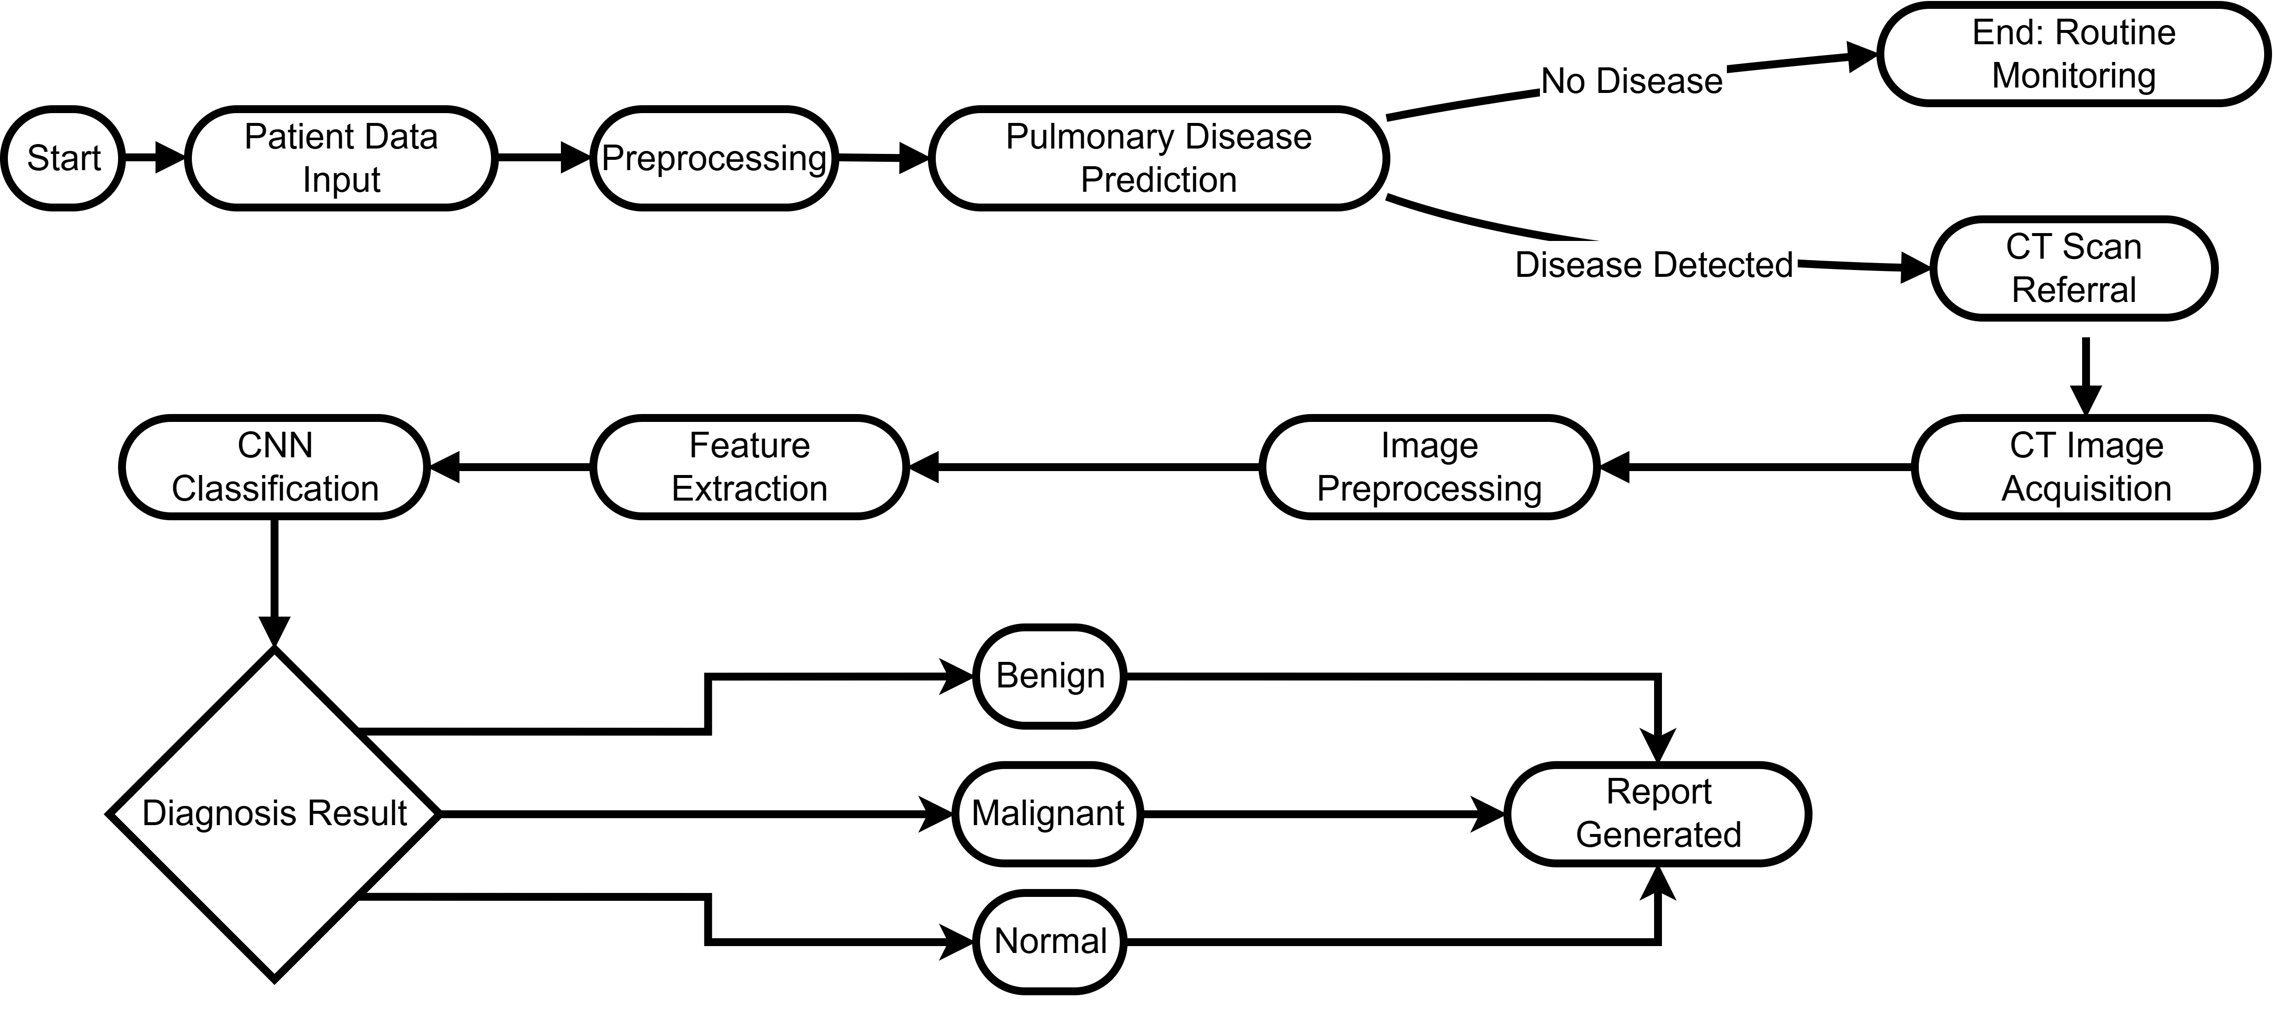
Workflow

Slide 14
Methodology
Problem Definition
Collected Datasets
Preprocess Data
Train ML Model
Future Improvements
Evaluate Model
Explain with SHAP
Predict Lung Cancer

Slide 15
1.Dataset Attributes
Lung Cancer Dataset (Text)
Age
Gender
Smoking
Finger Discoloration
Mental Stress
Exposure To Pollution
Long Ter Illness
Energy Level
Immune Weakness
Breathing Issue
Alcohol Consumption
Throat Discomfort
Oxygen Saturation
Chest Tightness
Family History
Smoking Family History
Stress Immune
Pulmonary Disease
Lung Cancer Dataset (CT Scan)
Benign Cases
Malignant Cases
Normal Cases

Slide 16
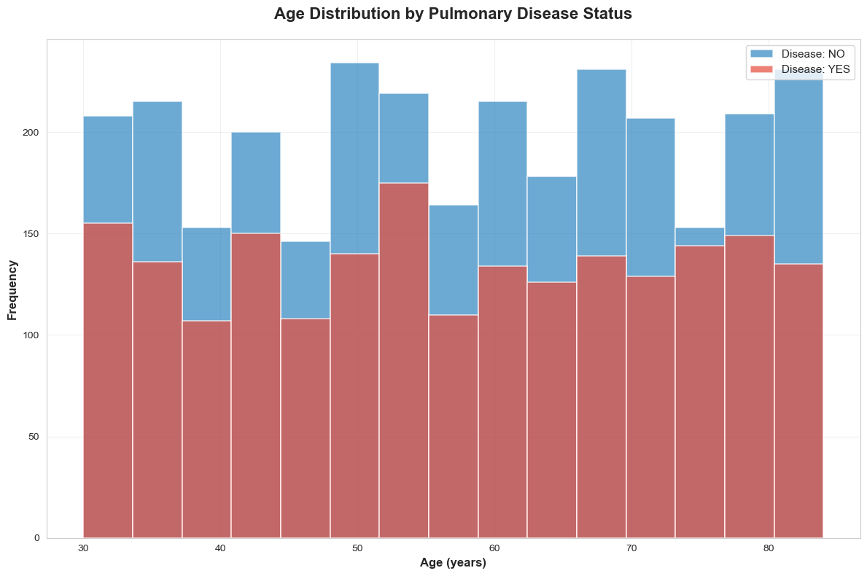
2. Data Visualization (Text Based)
Observations :
Pulmonary disease is present across all age groups from 30 to 80+.
Higher disease frequency is observed in age groups around 30, 50–60, and 80+.
In most age ranges, disease-positive cases (red) are equal to or more than disease-negative cases.
The 30-year age group shows an early spike, suggesting possible environmental or lifestyle factors.
Age groups 60–70 show a more balanced distribution, indicating mixed risk levels.

Slide 17
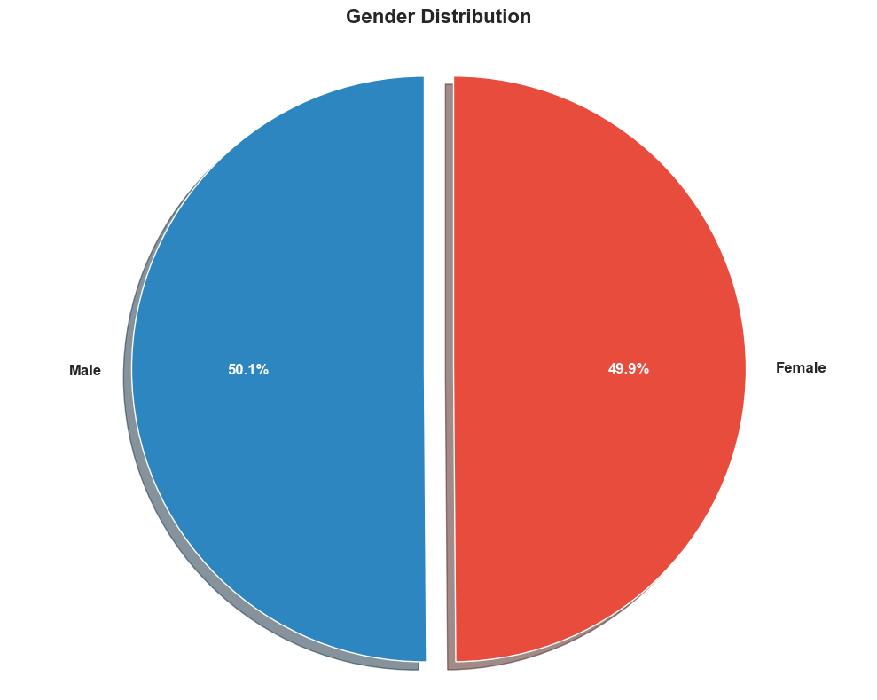
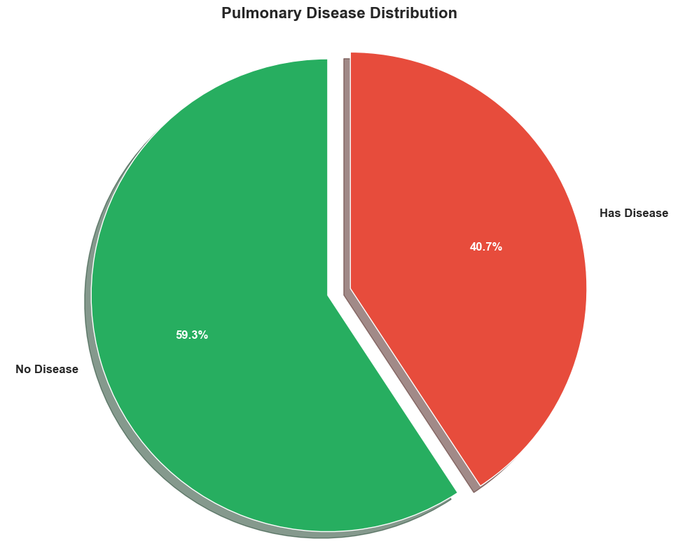
2.1 Gender and Pulmonary Disease Distribution

Slide 18
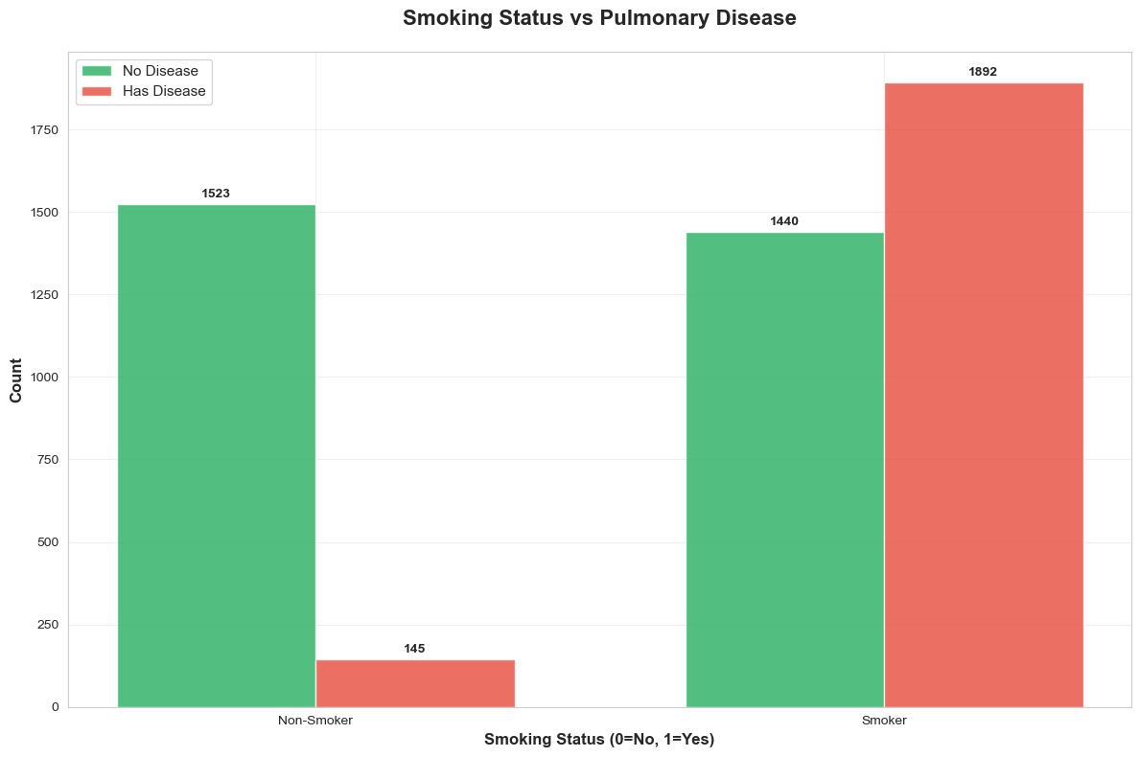
1.2 Smoking Status VS Pulmonary Disease
Observations :
Non-Smokers:
No Disease: 1523
Has Disease: 145
Majority of non-smokers are disease-free.
Smokers:
No Disease: 1440
Has Disease: 1892
Most smokers have pulmonary disease.
Key Insight:
Pulmonary disease is significantly more common among smokers, indicating a strong correlation between smoking and disease risk.

Slide 19
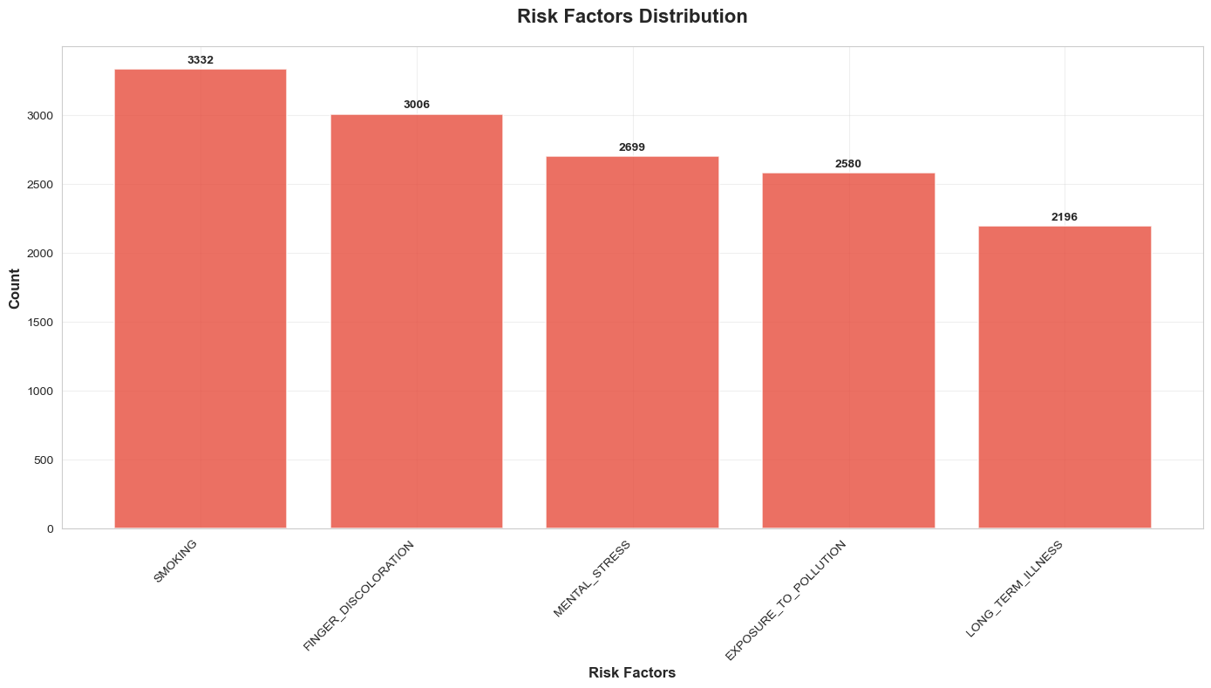
2.3 Risk Factor Distribution
Observations :
Smoking is the most common risk factor with 3332 individuals affected.
Finger Discoloration is the second most reported symptom, seen in 3006 cases.
Mental Stress impacts 2699 individuals, indicating a strong mind-body link.
Exposure to Pollution is present in 2580 records, showing environmental influence.
Long-Term Illness is observed in 2196 cases, highlighting chronic health conditions as a contributor.

Slide 20
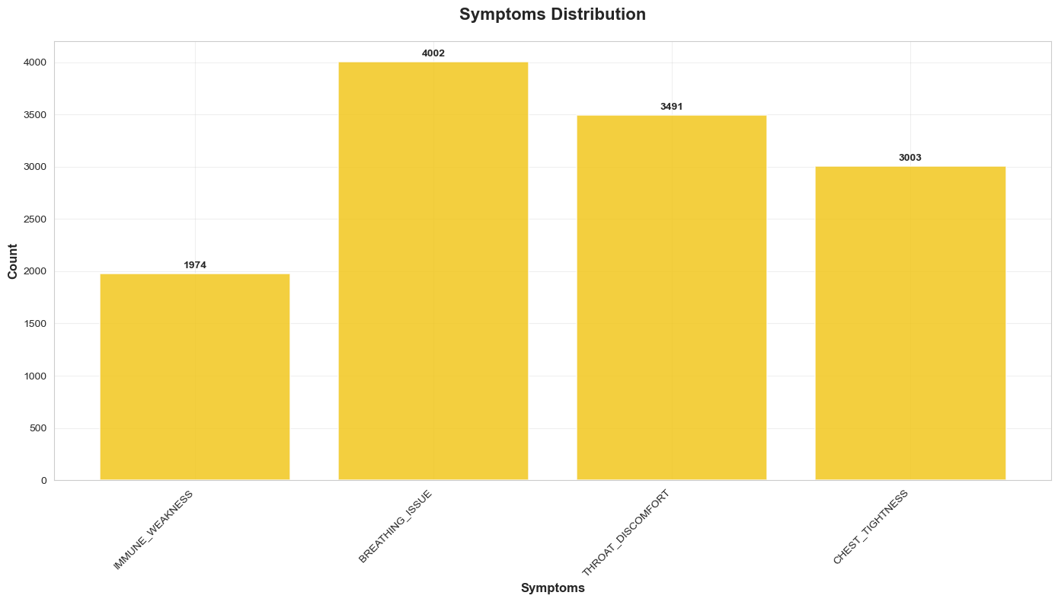
2.4 Symptoms Distribution
Observations :
Breathing Issue is the most reported symptom with 4002 cases, indicating it as a major clinical indicator.
Throat Discomfort follows with 3491 instances, showing strong relevance in pulmonary diagnosis.
Chest Tightness is observed in 3003 individuals, making it another common respiratory symptom.
Immune Weakness is the least common among the listed symptoms, with 1974 cases, but still significant.

Slide 21
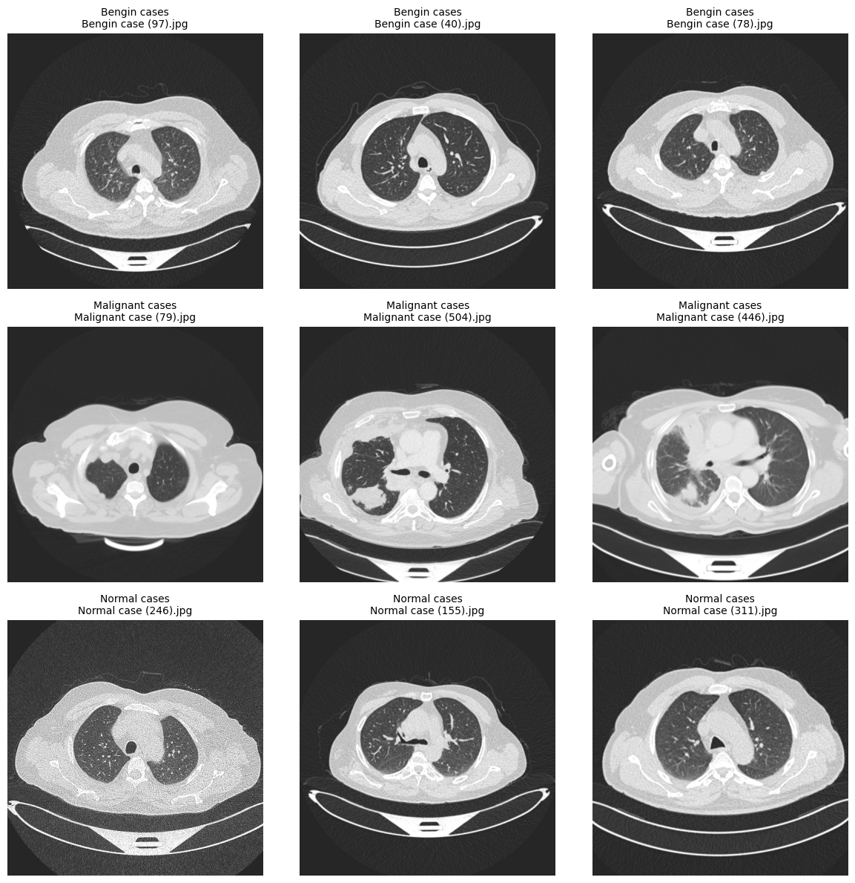
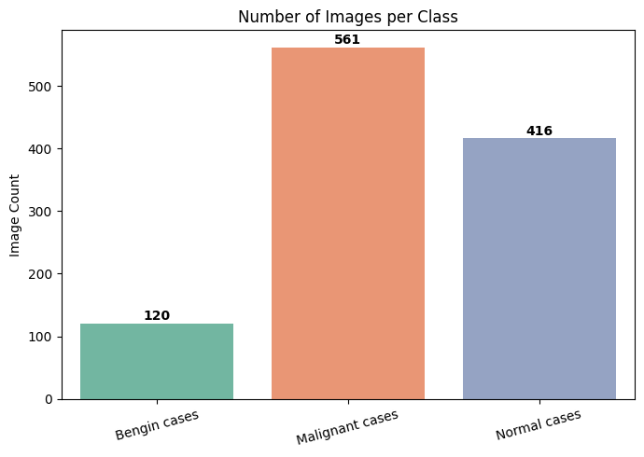
2. 5 Data Visualization(CT Scan based )

Slide 22
2.5.0 Attributes of CT Scan based Dataset
Benign Cases : These refer to non-cancerous lung nodules or tumors. Although abnormal, benign growths do not spread to other parts of the body and are generally not life-threatening. However, they may require monitoring or treatment to prevent complications.
Malignant Cases : These are cancerous lung tumors that can grow aggressively and spread (metastasize) to other parts of the body. Malignant cases require prompt diagnosis and treatment, including surgery, chemotherapy, or radiation therapy.
Normal Cases: These represent lungs with no detectable abnormalities, tumors, or signs of disease. Individuals in this class are considered healthy with respect to lung cancer diagnosis.

Slide 23
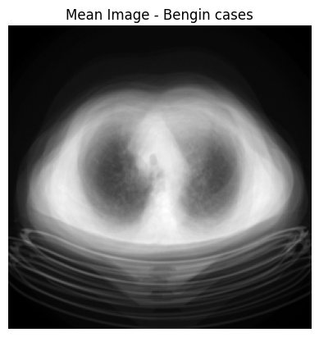
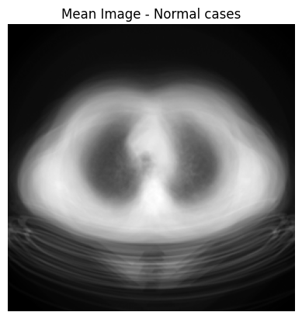
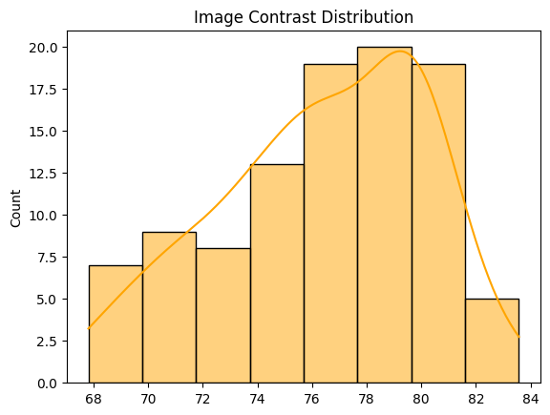
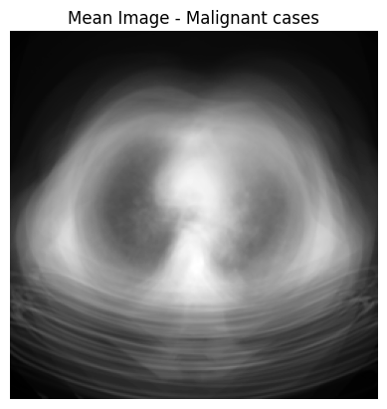
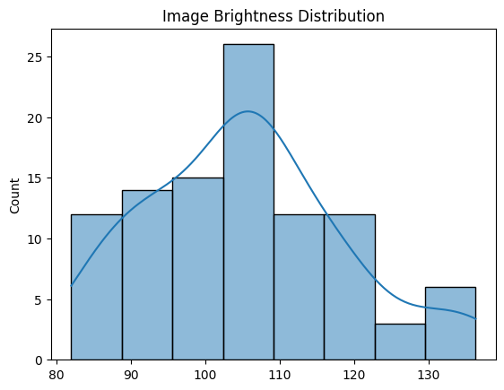
2. Data Visualization (CT Scan based )

Slide 24
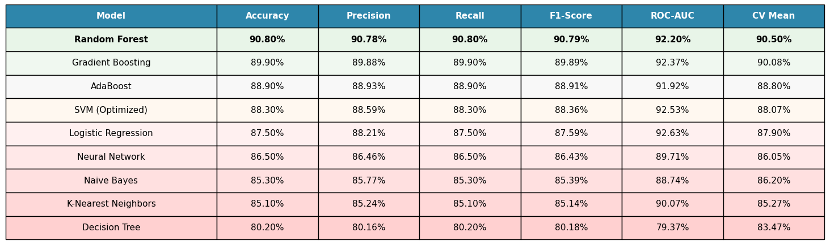
Model Evaluation for Textual Dataset
From the evaluation results, Random Forest emerged as the best-performing model with balanced metrics across accuracy, precision, recall, F1-score, ROC-AUC, and CV mean. Although we also experimented with a Stack Ensemble approach after Random Forest, it did not show improvements in precision and F1-score, even though the overall accuracy remained similar to Random Forest.

Slide 25
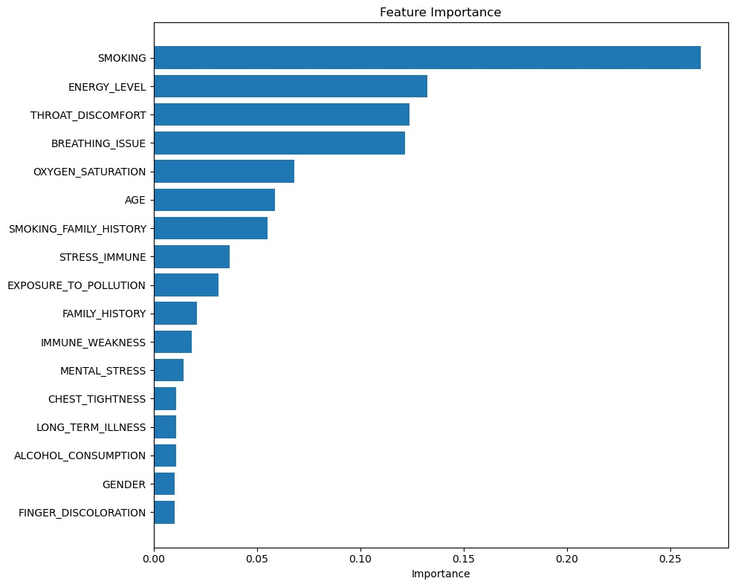
SHAP Implementation for Textual Data
by implementing SHAP (SHapley Additive exPlanations), we gain deeper insights into how each feature contributes to the model’s predictions. SHAP values quantify the positive or negative impact of individual factors on the outcome. For example, the SHAP analysis highlights smoking as the most influential factor in lung cancer prediction, followed by energy level, throat discomfort, and breathing issues.
These features strongly drive the model’s decisions, indicating their critical role in classification. Other contributors such as oxygen saturation, age, smoking family history, and exposure to pollution also play notable roles but with comparatively lower impact. Meanwhile, factors like finger discoloration, gender, and alcohol consumption have minimal influence on the predictions.
This demonstrates that lifestyle-related risks (especially smoking), health symptoms, and physiological indicators are the most significant determinants in the model’s decision-making process.

Slide 26
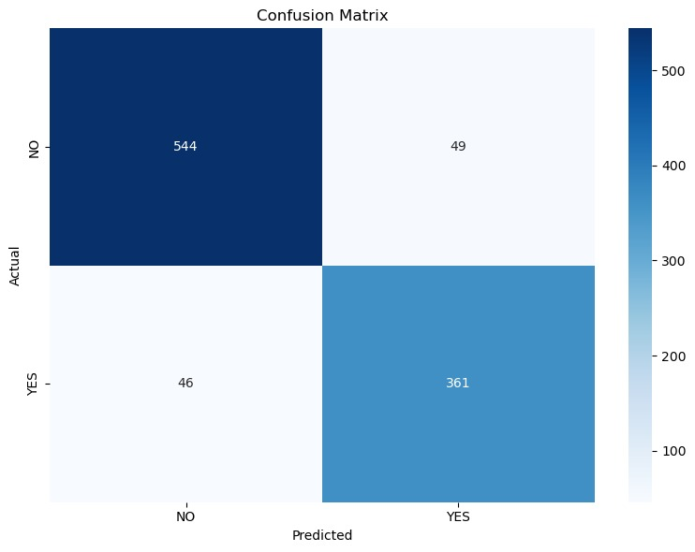
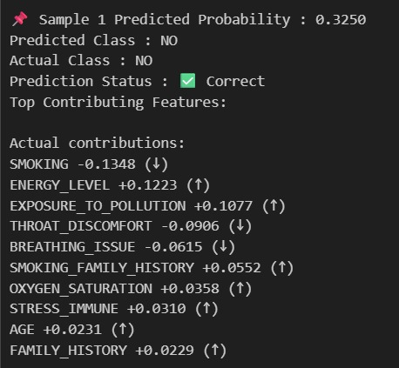
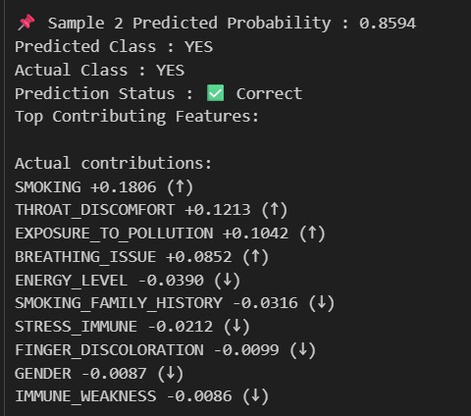
Results for Textual Data
The confusion matrix indicates that the model performs well, correctly classifying 544 NO cases and 361 YES cases, with only 95 misclassifications (49 NO cases predicted as YES and 46 YES cases predicted as NO). This demonstrates strong overall accuracy and balanced performance across both classes.
Additionally, the feature contribution analysis shows how different factors influence predictions. For instance, smoking, throat discomfort, and exposure to pollution strongly contributed to positive (YES) predictions, while higher energy levels, oxygen saturation, and absence of symptoms contributed to negative (NO) predictions.

Slide 27
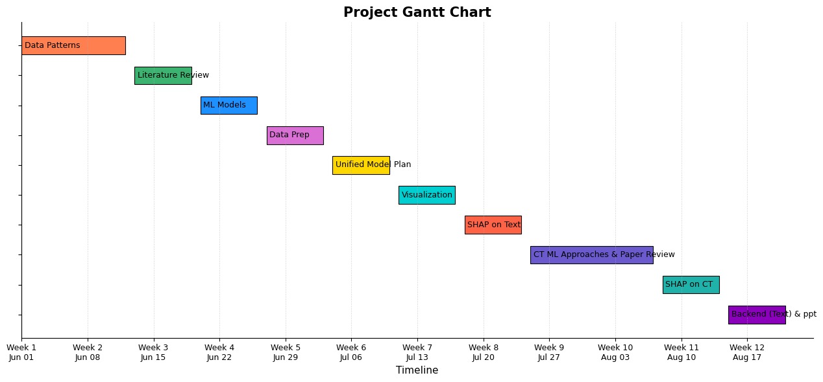
Gantt Chart

Slide 28
Tech Stack
Machine Learning Algorithms
Explainable AI Framework
Programming Language
Libraries & Tools
SHAP (SHapley Additive exPlanations)
Python
Scikit-learn
Matplotlib / Seaborn (for data visualization)
Pandas, NumPy (for data processing)
Random Forest
Logistic Regression
Gradient Boosting
AdaBoost
Support Vector Machine (SVM)
K-Nearest Neighbours (KNN)
Naive Bayes
Neural Network
Decision Tree
CNN Architectures: DenseNet121, ResNet50, EfficientNet-B0
Image Processing & Deep Learning (for CT scans)
Dataset Source
OpenCV
TensorFlow / Keras
Grad-CAM (for visual explainability in CNNs)
Kaggle (Text-based + CT Scan Image Dataset)
Frontend & Backend tools
FastAPI (backend integration)
ReactJS (frontend developed)

Slide 29

Second Phase Works
CT Scan Image Training: We will using deep learning techniques to extract meaningful patterns, followed by fine-tuning and evaluation.
Model Combination Experiments We plan to experiment with different combinations of machine learning models to explore whether ensemble or hybrid approaches can yield higher accuracy than our current best-performing model.
Multimodal Model Integration We aim to combine the CT scan image-based model with the text-based model to build a comprehensive, multimodal prediction system. This integrated approach is expected to enhance performance by capturing both visual and clinical data patterns.
Enhanced Feature Engineering & Tuning Future work will also include deeper hyperparameter tuning and feature selection techniques to optimize model performance further.

Slide 30
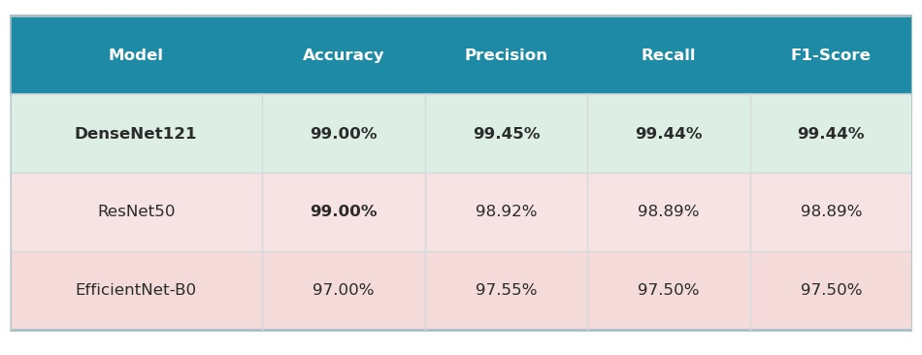
Model Evaluation for Image Based Data CT-Scans)
Of all the assessed deep learning architectures, DenseNet121 performed the best, having a precision of 99.45%, recall of 99.44% and an F1-score of 99.44%, and an accuracy of 99%. Although ResNet50 achieved also 99% accuracy, it performed a bit worse in terms of precision and F1-score. EfficientNet-B0 gave decent results being nearly able to compete with 97 percent against DenseNet121 and ResNet50. On balance, DenseNet121 is the most successful and stable model that may be used in this task.

Slide 31
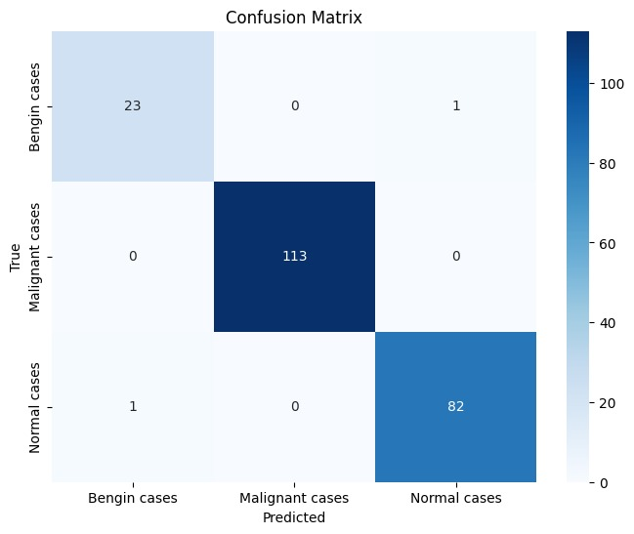
Results for Image Based Data CT-Scans)
The confusion matrix shows that the model performs exceptionally well across all three classes. Out of 220 total cases, it correctly classified 23 benign, 113 malignant, and 82 normal cases, with only 2 misclassifications (1 benign case predicted as normal and 1 normal case predicted as benign). This demonstrates that the model achieves very high accuracy and strong discriminative power, particularly for malignant cases where it achieved perfect classification (113/113).

Slide 32
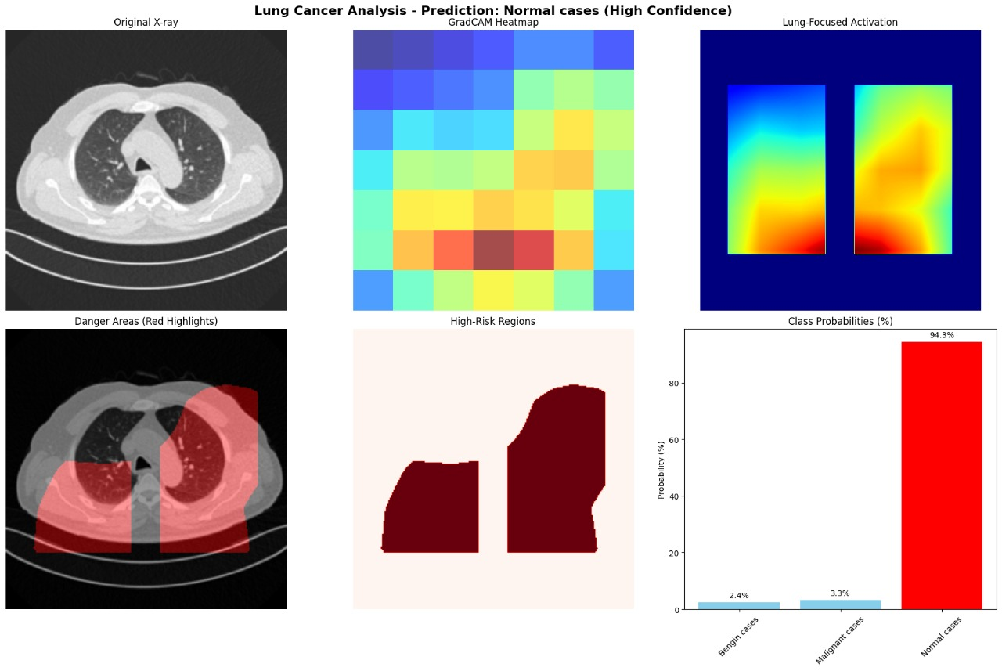
Results for Image Based Data (CT-Scans)
The model predicts the case as normal with high confidence (94.3%). Grad-CAM heatmaps and lung-focused activations show minimal abnormal activity, and highlighted regions do not indicate significant risk areas. With very low probabilities for malignant (3.3%) and benign (2.4%) cases, the analysis strongly supports a normal, healthy lung condition.

Slide 33
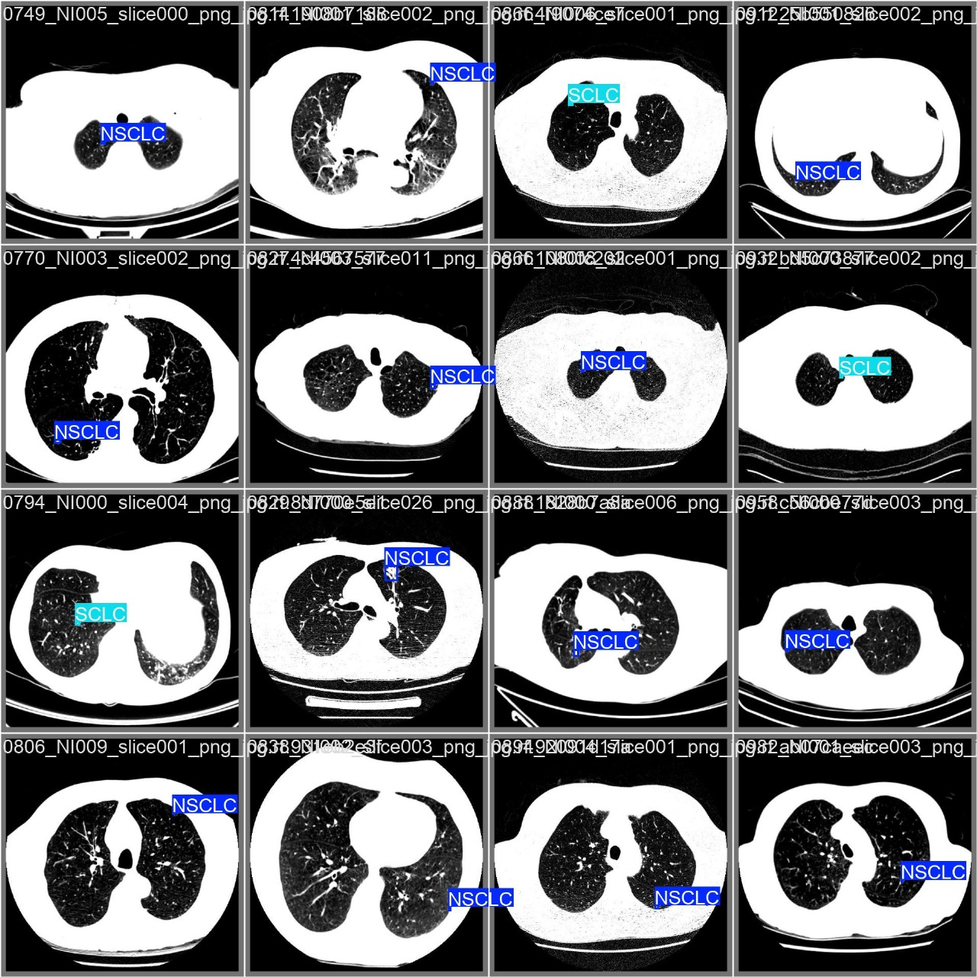
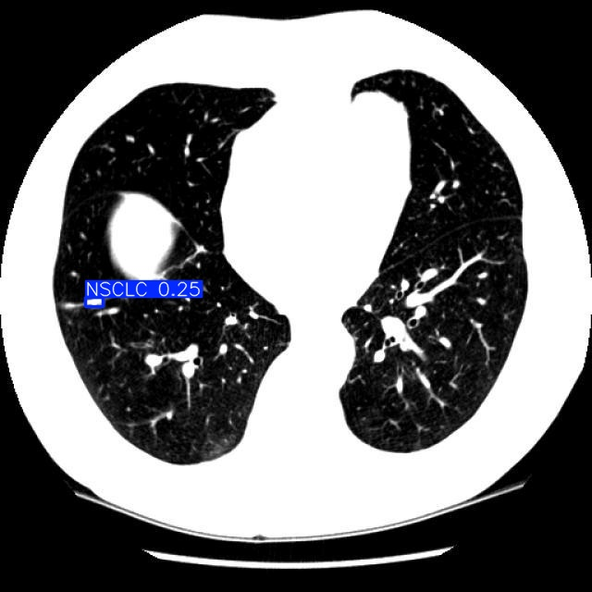
Results for Image Based Data CT-Scans)

Slide 34

Phase II Progress Update
All Phase 2 tasks completed
Improvements & limitations from Review 1 resolved
CT-Scan images included (as suggested in Review 1)
FastAPI backend ready
Frontend developed
Remaining Task: Model integration with web application

Slide 35

Conclusion
This project successfully demonstrates the effective application of Machine Learning and Explainable AI techniques in the early prediction of lung cancer. By utilizing both clinical text-based data and CT scan images, we achieved high accuracy and reliability in classification tasks. Among the implemented models, Random Forest, Logistic Regression, and DenseNet121 delivered the best results, while SHAP and Grad-CAM enhanced interpretability by making the predictions transparent and trustworthy for healthcare professionals. The analysis highlighted critical risk factors such as smoking, age, throat discomfort, breathing issues, and exposure to pollution, reaffirming their significance in lung cancer diagnosis. Overall, this work validates the potential of AI in healthcare diagnostics, emphasizing the importance of explainability in real-world clinical adoption. Moving forward, the integration of multimodal approaches combining text and image data, advanced ensemble methods, and deployment as a web-based clinical support tool are expected to further improve accuracy, reliability, and practical usability in medical environments.

Slide 36
References
[1] S. N. Tisha and S. A. Ani, “Predictive Insights: Empowering Early Detection of Lung Cancer Using Machine Learning Excellence,” in 2024 IEEE Region 10 Symposium, TENSYMP 2024, Institute of Electrical and Electronics Engineers Inc., 2024. doi: 10.1109/TENSYMP61132.2024.10752136.
[2] S. Murthy Nimmagadda, K. Likhitha, G. Srilatha, and S. M. Sree, “Lung Cancer Prediction and Classification Using Machine Learning Algorithms,” in Proceedings - 2024 International Conference on Expert Clouds and Applications, ICOECA 2024, Institute of Electrical and Electronics Engineers Inc., 2024, pp. 1012–1015. doi: 10.1109/ICOECA62351.2024.00176.
[3] Mohammad Shafiquzzaman Bhuiyan et al., “Advancements in Early Detection of Lung Cancer in Public Health: A Comprehensive Study Utilizing Machine Learning Algorithms and Predictive Models,” Journal of Computer Science and Technology Studies, vol. 6, no. 1, pp. 113–121, Jan. 2024, doi: 10.32996/jcsts.2024.6.1.12.
[4] S. P. Maurya, P. S. Sisodia, R. Mishra, and D. P. singh, “Performance of machine learning algorithms for lung cancer prediction: a comparative approach,” Sci Rep, vol. 14, no. 1, Dec. 2024, doi: 10.1038/s41598-024-58345-8.
[5] Joy Chakra Bortty et al., “Optimizing Lung Cancer Risk Prediction with Advanced Machine Learning Algorithms and Techniques,” Journal of Medical and Health Studies, vol. 5, no. 4, pp. 35–48, Oct. 2024, doi: 10.32996/jmhs.2024.5.4.7.
[6] K. Moon and A. Jetawat, “Predicting Lung Cancer with K-Nearest Neighbors (KNN): A Computational Approach,” Indian J Sci Technol, vol. 17, no. 21, pp. 2199–2206, May 2024, doi: 10.17485/IJST/v17i21.1192.
[7] R. K. Pathan, I. J. Shorna, M. S. Hossain, M. U. Khandaker, H. I. Almohammed, and Z. Y. Hamd, “The efficacy of machine learning models in lung cancer risk prediction with explainability,” PLoS One, vol. 19, no. 6 June, Jun. 2024, doi: 10.1371/journal.pone.0305035.

Slide 37
References
[8] M. Mamun, A. Farjana, M. Al Mamun, and M. S. Ahammed, “Lung cancer prediction model using ensemble learning techniques and a systematic review analysis,” in 2022 IEEE World AI IoT Congress, AIIoT 2022, Institute of Electrical and Electronics Engineers Inc., 2022, pp. 187–193. doi: 10.1109/AIIoT54504.2022.9817326.
[9] S. Agarwal, S. Thakur, and A. Chaudhary, “Prediction of Lung Cancer Using Machine Learning Techniques and their Comparative Analysis,” in 2022 10th International Conference on Reliability, Infocom Technologies and Optimization (Trends and Future Directions), ICRITO 2022, Institute of Electrical and Electronics Engineers Inc., 2022. doi: 10.1109/ICRITO56286.2022.9965052.
[10] P. Chaturvedi, A. Jhamb, M. Vanani, and V. Nemade, “Prediction and Classification of Lung Cancer Using Machine Learning Techniques,” IOP Conf Ser Mater Sci Eng, vol. 1099, no. 1, p. 012059, Mar. 2021, doi: 10.1088/1757-899x/1099/1/012059.
[11] A. Ampuh. Yunanto, 2020 International Electronics Symposium : September 29-30th 2020, Surabaya, Indonesia. IEEE, 2020.
[12] T. Kadir and F. Gleeson, “Lung cancer prediction using machine learning and advanced imaging techniques,” Jun. 01, 2018, AME Publishing Company. doi: 10.21037/tlcr.2018.05.15.
[13] Dataset Link: https://www.kaggle.com/datasets/adityamahimkar/iqothnccd-lung-cancer-dataset

Slide 38
Q&A

Slide 39


